Slide 1
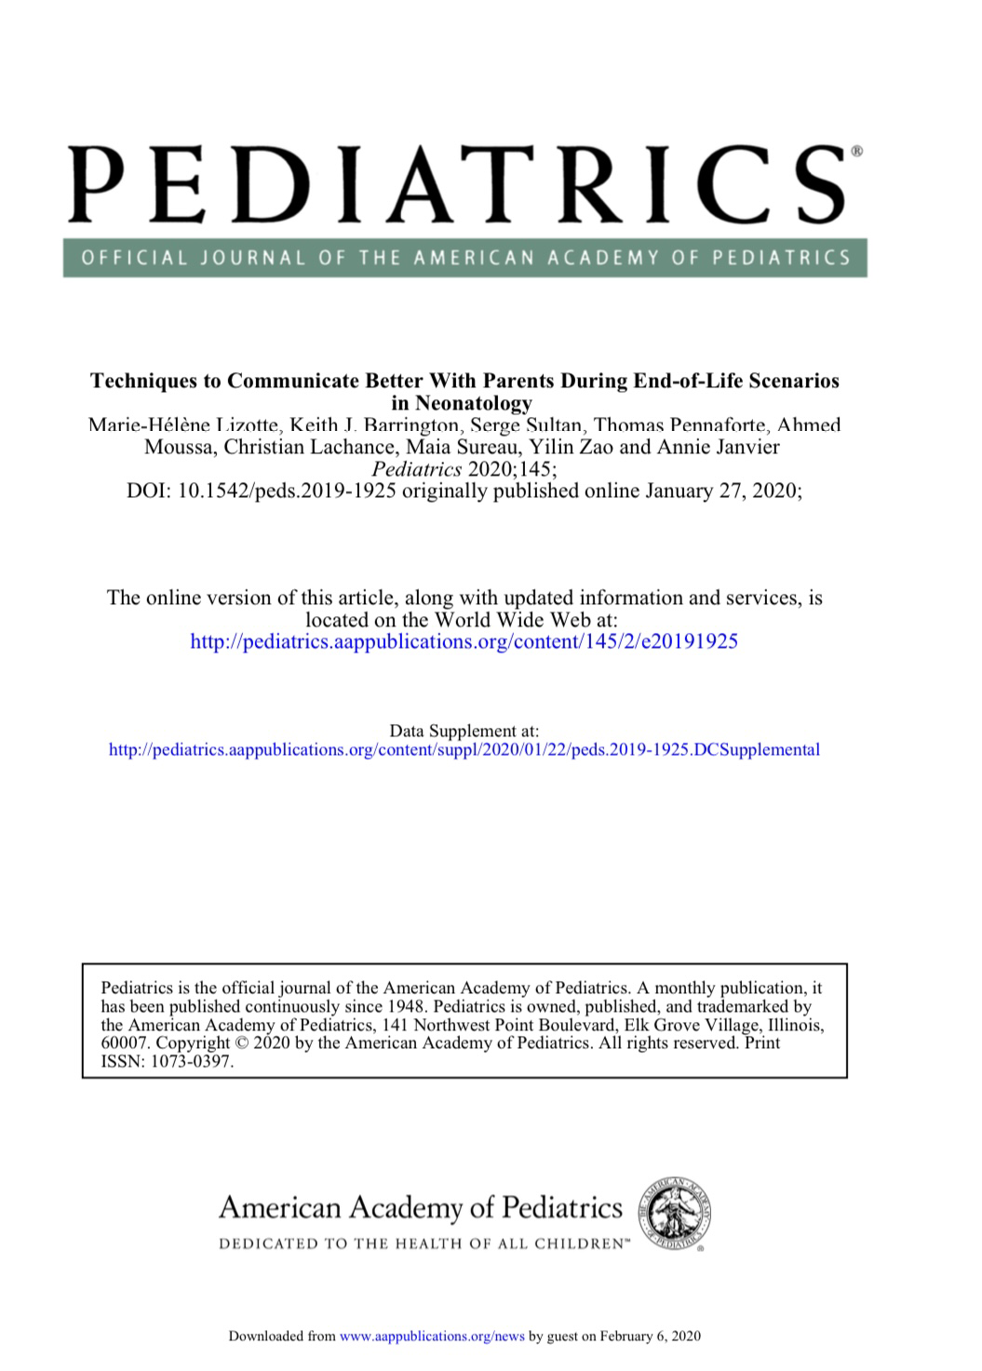

Slide 2
Obstract
BACKGROUND AND OBJECTIVES: Clinicians are urged to optimize communication with families,generally without empirical practical recommendations. The objective of this study was to identify core behaviors associated with good communication during and after an unsuccessful resuscitation, including parental perspectives.METHODS: Clinicians from different backgrounds participated in a standardized, videotaped, simulated neonatal resuscitation in the presence of parent actors. The infant remained pulseless; participants communicated with the parent actors before, during, and after discontinuing resuscitation. Twenty-one evaluators with varying expertise (including 6 bereaved parents) viewed the videos. They were asked to score clinician-parent communication and identify the top communicators. In open-ended questions, they were asked to describe 3 aspects that were well done and 3 that were not. Answers to open-ended questions were coded for easily reproducible behaviors. All the videos were then independently reviewed to evaluate whether these behaviors were present.RESULTS: Thirty-one participants’ videos were examined by 21 evaluators (651 evaluations). Parents and actors agreed with clinicians 81% of the time about what constituted optimal communication. Good communicators were more likely to introduce themselves, use the infant’s name, acknowledge parental presence, prepare the parents (for the resuscitation, then death), stop resuscitation without asking parents, clearly mention death, provide or enable proximity (clinician-parent, infant-parent, clinician-infant, mother-father), sit down, decrease guilt, permit silence, and have knowledge about procedures after death. Consistently, clinicians who displayed such behaviors had evaluations .9 out of 10 and were all ranked top 10 communicators.CONCLUSIONS: During a neonatal end-of-life scenario, many simple behaviors, identiﬁed by parents and providers, can optimize clinician-parent communication.

Slide 3
METHODSThe study took place in Sainte-Justine hospital, a tertiary care mother-child hospital afﬁliated with the University of Montreal, with ∼4000 deliveries a year and a 67-bed NICU.Simulation SessionWe used similar methods reported in our previous studies. 11,12 Participants performed a videotaped simulation using a high-ﬁdelity manikin assisted by a Neonatal Resuscitation Program (NRP)–trained provider (neonatal nurse or respiratory therapist). They were informed that 2 actors, playing the role of the parents, would be present at the resuscitation and to interact with them as they would do in practice. A term neonate would be born after an urgent cesarean delivery for fetal distress. They had 3 minutes to prepare for the birth. The manikin was programmed to remain pulseless despite resuscitation. Standardized actors were trained and followed speciﬁc guidelines (Supplemental Information). Immediately after each simulation, standardized debrieﬁng occurred.11 Recruitment of ParticipantsTo be representative of the diversity of clinicians who participate in resuscitations in our institution, we aimed to recruit 30 NRP-trained participants, with varying backgrounds and experience.

Slide 4
Results
Thirty-one participants were recruited: 15 pediatric residents (6 junior [postgraduate year 1 and 2] and 9 senior residents [postgraduate year 3 or 4]), 5 neonatal fellows, 3 neonatologists, 3 neonatal nurse practitioners, and 5 transport and resuscitation team providers (2 nurses and 3 respiratory therapists). The videos were analyzed by 21 evaluators: 3 involved in the simulation (the 2 standardized actors and the assisting clinician), 6 members of the neonatal team (1 neonatologist, 1 fellow, 2 nurses, 2 neonatal nurse practitioners), 2 obstetrics providers (a maternal-fetal medicine specialist and a nurse), 1 pediatrician, 3 allied health professionals (social worker, psychologist, and respiratory therapist), and 6 parents. Nine potential parent participants were contacted (Supplemental Information): 8 answered the invitation, 1 declined, and another did not confirm his participation.Six participated: 4 mothers and 2 fathers. Five had experienceda neonatal death, and the sixth had an infant who facedongoing complex medical problems and had had 3 extensive resuscitations.

Slide 5
Evaluation of the Interaction Between Providers and ParentsEach video was examined by 21 evaluators, leading to 651 evaluations. In all groups, communication scores were lower during the resuscitation.
Neonatologists, fellows, and the transport team and neonatal nurse practitioners had higher scores than residents for communication after the resuscitation.

Slide 6
Positive and Negative InteractionsIn each of the 651 evaluations, 3 positive and 3 negative evaluator comments were identified, for a total of 3906 items, which were subject to thematic analysis.

Slide 7
Communication Before the ResuscitationAlthough evaluators were not asked to score communication before the resuscitation, 16 evaluators reported (in open-ended questions) examples of positive and/or negative interactions between providers and parents during the 3-minute preparation time (Table 2). At least 1 of 3 positive main themes were invoked by all evaluators. Good communicators (1) introduced themselves in simple language, (2) asked the name of the infant and used it, and (3) prepared the parents for a potentially difficult situation(Table 2).

Slide 8
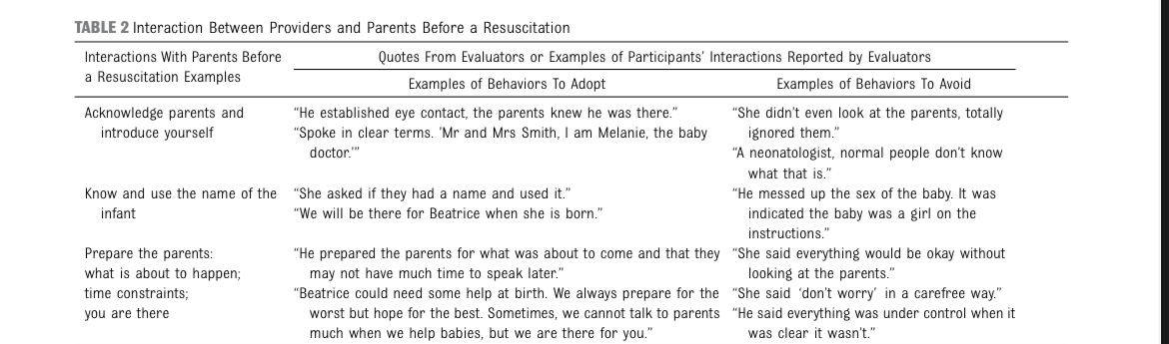

Slide 9
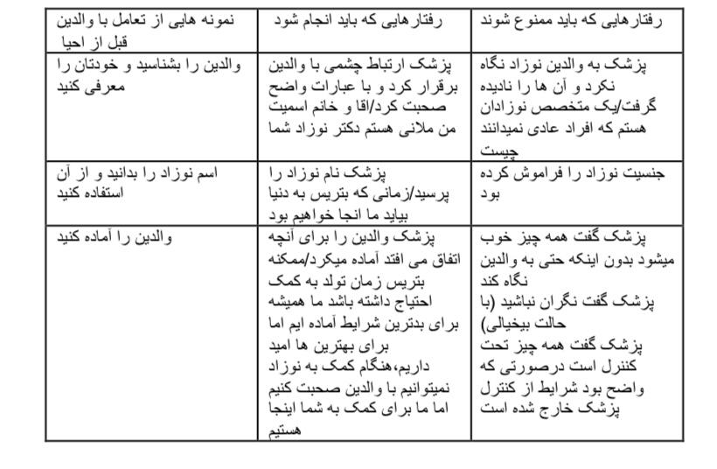

Slide 10
Communication During the ResuscitationWhen identifying positive interactions during the resuscitation, evaluators invoked 6 themes (between 2 and 6 per evaluator) (Table 3). Good communicators (1) recognized the presence of the parents and allowed the father to approach the bedside; (2) used the name of the infant; (3) prepared the parents for death in a stepwise fashion; (4) used the wordsdeath, dying, or dead; (5)remained calm; and (6) made a clear decision to stop the resuscitation without asking parents’ permission (Table 3).

Slide 11
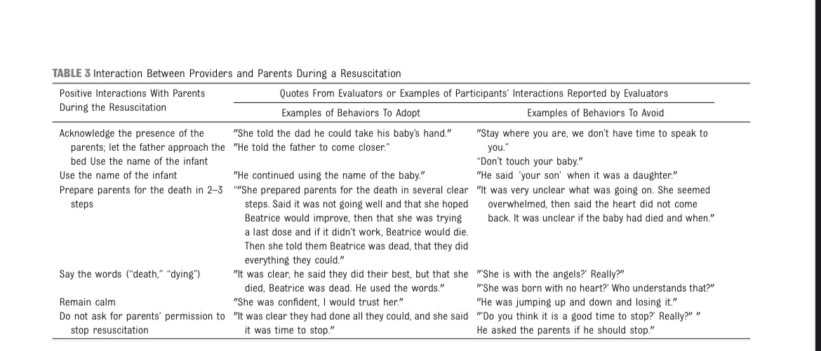

Slide 12
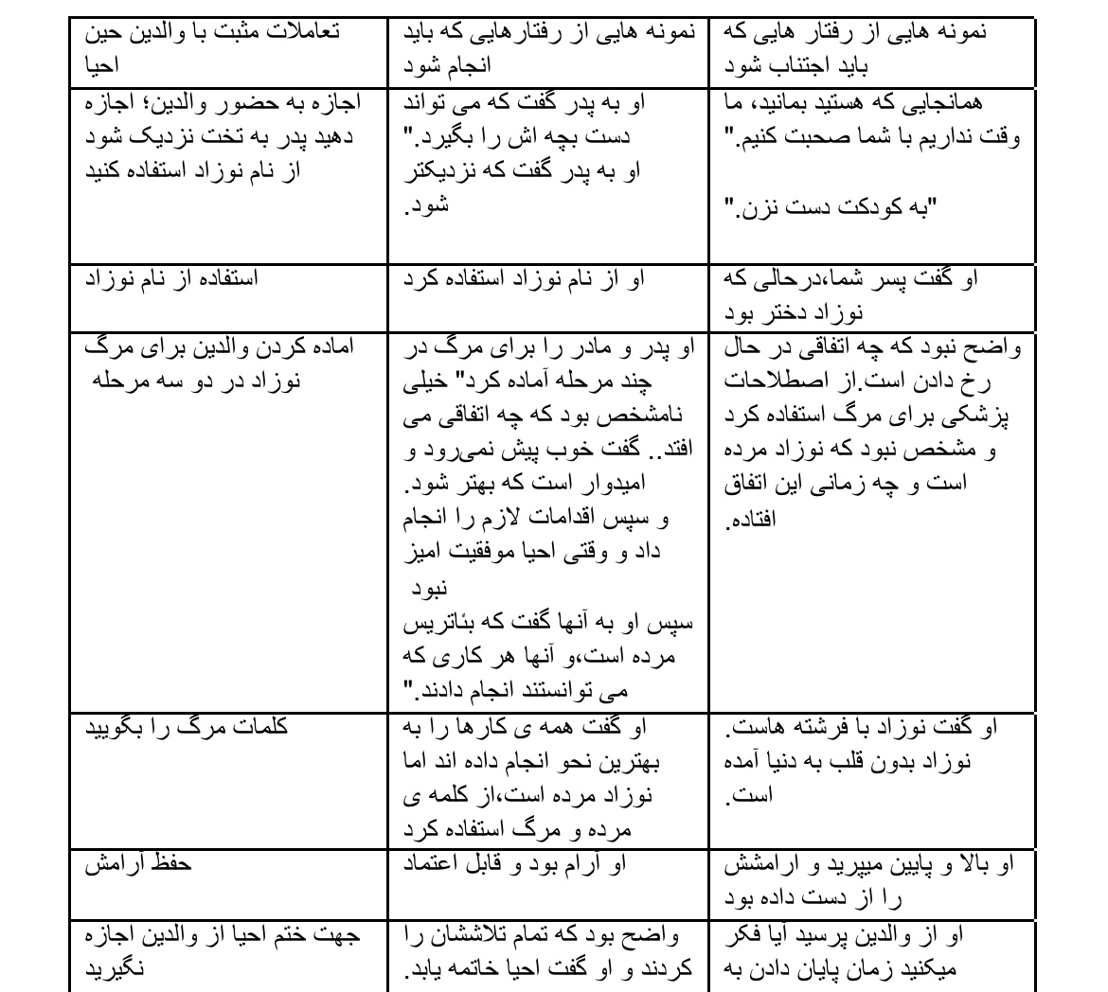

Slide 13
Communication After the ResuscitationWhen identifying positive interactions, evaluators invoked 8 themes (between 3 and 8 themes invoked per evaluator): (1) clearly and unambiguously stating the infant had died, (2) avoiding medical jargon and metaphors related to death, (3) making a clear statement that this was not the fault of the parents, (4) listening to the parents and providing silence, (5) providing proximity (either between clinician-parent, mother-father, clinician-infant, and/or parents-infant), (6) speaking about what happens after a death, (7) offering support fromhospital staff and parents’ loved ones, and (8) offering future support (Table 4).

Slide 14
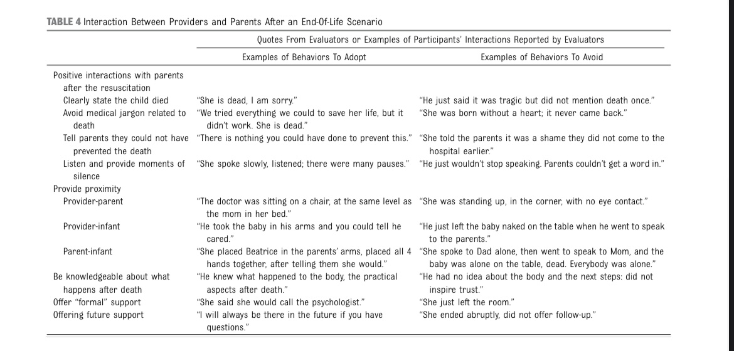

Slide 15


Slide 16
Top Communicators and Use of Words Associated With CompassionEach of the 31 evaluators identified 10 top communicators, for atotal of 310 votes. The top 10 communicators were more likely to be neonatologists or neonatal fellows (P = .035). There was broad agreement about the top 10 communicators, 8 of whom were scored in the top 10 by 81% of evaluators; 2 others were scored in the top 10 by 62%. One or more of the following 5 words were more likely to be used in the positive comments for top 10 communicators: “empathy,” “compassion,” “warm,” “human,” or “trust” (P , .001). Notably, when these words were used in the negative (“lackingempathy,” “not compassionate,” etc), participants were never in the top 10.

Slide 17
Behavior CodingIn the list of all possible positive interactions, 21 behaviors that can easily be observed were identified. For example, “sitting down” and “using the infant’s name” were identified. In contrast, “empathy” or “compassion,” which are subjective, were not. Then, all the videoswere reviewed by an independent reviewer to examine whether these behaviors were present (Table 5); 90% of the top 10 communicators adopted at least 20 of these 21 behaviors. Importantly, such behaviors were stronglyassociated with the use of the words “empathy,” “compassion,” “warm,” “human,” and “trust” in the open- ended evaluators’ comments (P , .001; use of 1 of the 5 words). Providers who displayed all 21behaviors had evaluations .9 out of 10 by all evaluators.

Slide 18
Differences in Scoring Between EvaluatorsCommunication scores and rankings given by neonatal and non-neonatal providers were generally similar. Actors gave significantlyhigher scores compared with the others (P = .04), and parent evaluators gave lower scores compared with provider evaluators (P = .045). Discrepancies of .2 points, on our scale of 10,between evaluations occurred in 19% of the 651 evaluations. The 6 participants who had discrepant scores usually had lower scoresfrom parent evaluators, who had different perspectives from providers and actors. Discrepancies were mainly related to the language participants used related to death. For example, parents had problems understanding some sentences, orthought they were insensitive: “your infant was born without a heart” or “her heart never came back.” Some of the language commonly used in the medical field was judged to be negative by all parent evaluators, for example, “letting the infant die” or “allowing natural death.” Other discrepancies were less common. For example, 1 of the participants placed the hands of the father on the infant early in the resuscitation, eventually showed him how to provide cardiacmassage, asked him to provide it, and went to speak to the mother for 20 seconds, informing her that resuscitation would be stopped and that her infant was dead and would be in her arms soon. All parents evaluated this participantfavorably (scores .8), even using this as an example of a positive interaction. In contrast, provider evaluators were critical and gave low marks, using this example as something to avoid

Slide 19
Discussion
This is the first study to evaluate communications skills duringa simulated end-of-life scenario, with interdisciplinary participation and evaluation. The goal was to identify core behaviors that could be easily taught and emulated. All participants were adequate in their technical and communication skills, and they were NRP trained and often participated in resuscitations, some rarely as team leader. The evidence regarding how to communicate with families beforea critical delivery or when a child becomes unstable is scarce and generally not addressed in resuscitation manuals. A resuscitation team may only have seconds to communicate with parents, but our results show that this time can be used effectively. Similarly, there is scarce evidence regarding communication with families during resuscitations. Although parental presence remains controversial,18–24 the mother is inevitablyphysically present at birth (although sometimes under general anesthesia) and the father is often there.The communication scoresduring the resuscitation werethe lowest. Indeed, this task is complex because it requires multitasking by the code leader. Ideally, a provider would be dedicated to do this task. Several institutions have developed specific training guidelines for such a familysupport role.25,26 Realistically, in these rare situations, the additional personnel (when they exist) are generally diverted to help with the resuscitation. In this study, it was possible for more than half of the participants to communicate well (scores .80%), using 6 core behaviors. This took a total time ofless than a minute and was feasible while leading a resuscitation.Optimal communication afterdeath comprised many elements.Not surprisingly, some of the behaviors identified in thisarticle been described in the literature27: for example,guidelines on how to give bad news28,29 or how to speak to parents about life-and-death issues.30 Yet, none of these publications include all the core behaviors described in this empirical investigation.

Slide 20
Neonatologists and neonatal fellows had higher evaluations on average, suggesting that experience is important to improve skills. On the other hand, some junior residents with limited clinical experience were highly scored. Some seem to have “natural skills” for these interactions. To those who have this natural talent, our results may seem infantilizing: “introduce yourself,” “use the infant’s name,” “clearly state that theinfant has died,” or “sit down.” Interestingly, when we asked the top communicators to describe what they did, they were mostly unable to inform us clearly, they “just did what they usually do.” But even “natural communicators” have bad days or days when these situations happen at a bad time, for example, at the end of a long call. In these situations, these core behaviors can be used asa checklist to make sure parents feel well treated. For those who start their training or for whom these interactions are stressful or come less naturally, it is possible to be “good with parents” by adopting some simple behaviors and avoiding others because these are perceived acutely by parents and classified consistently by professionals (Fig 1). Institutions can also have an impact on these core behaviors, for example, by including the name and/or sex of the child during “time-outs” before an urgent delivery or by making sure there are chairs available in all rooms where resuscitations and/ordeaths occur.It is not rare to hear thata compassionate provider is one with a good heart and that intentions are what counts.Some may consider such behaviors as less virtuous when they are part of checklists. Unfortunately, empathy and good intentions may not be enough. Caring clinicians can inadvertently display behaviors that are judged to be insensitive, such as leaving the dead infant alone or not usinghis or her name. Clinicianscan display behaviors that ensure families will feel well cared for in these difficult moments, even if sometimes it may not “come from the heart.”

Slide 21
Although evaluators generally agreed, in some cases, parent evaluators disagreed with nonparent evaluators. We should remember the language we use to speakabout death can be unclear. Although the actors were lay people, they were probably too involved with the medical world to realize some sentences made little sense or could be insensitive tofamilies. Parents’ criticisms mainly had to do with jargon related to death (“born without a heart”), but some were about elaborate vocabulary, such as “allow natural death.” This vocabulary evolves in academic circles, without stakeholder involvement. We were also sometimes surprised by parental evaluations, for example, judging favorably the inclusion of the father-actor providing cardiac massage. This is a reminder thatwe should remain humble and curious and always include stakeholders in these kinds of investigations. The inclusion of parent evaluators in this study gave us unique insights. It was alsoa complex endeavor. Bereaved stakeholders are often notincluded in research or clinical initiatives because of risks tothem. Although they are indeeda vulnerable population, excluding them from such activities omits an important and often complementary perspective.

Slide 22
This study has several limitations. It was performed in a single center, and results may be different in other centers. On the other hand, because we examined the perspectives of diverse evaluators on various resuscitators and communicators, which lead to .600 evaluationsand almost 4000 examples of positive and negative interactions, the main core behaviors would probably be similar. These core behaviors are a skeleton on which to build additional skills with practice and training. Cultural sensitivity and flexibility intheir application is also important. For example, in some cultures,the infant is not named before birth. This was also a simulation study, and it is unknown whether these scenarios would exactly translate to a real-life experience. The evaluations were also based on high-_fidelity videos, which leads to limitations. On the other hand, investigating these resuscitations in real life would be almost impossible.The simulations were also limited to 1 scenario. We used this scenario because it had previously been safely used with trainees.11 However, many of these core behaviors could be applied in other circumstances that are more frequent within the NICU,4 such as when an infant with respiratory failure becomes bradycardic and eventually dies,with or without extensive cardiopulmonary resuscitation. Developing these “hybrid” technical communication simulations was also appreciated by trainees. These could be developed for other situations. Neither the NRP nor the Pediatric Advanced Life Support textbooks include a score sheet related to interaction with parents. Some of the core behaviors identified in this study could be considered objective behaviors to validate in future studies.

